Slide 1
PRESENTATION ON ROUTING ALGORITHM
PRESENTED BY:-
SUSAN KHATRI
AMRITA REGMI
ROSHNI NEUPANE
BHARAT KHANAL BIKASH CHAUDHARY SHARAMSHA THAPA

Slide 2
AGENDA :-
Routing protocols
Routing issues
Routing algorithm
Fixed path routing
Shortest path routing
Flooding
Distance vector routing
Link state routing

Slide 3
Routing protocol
Allows the router to communicate with others router by updating and maintaining routing table
POPULAR ROUTING PROTOCALS ARE:
Routing information protocol(RIP)
Open Shortest Path First
Interior Gateway Routing Protocol (IGRP)

Slide 4
ROUTING ISSUES
Scalability:-Able to support large number of hosts, routers and networks.
Adaptability:-adapt change in topology/ significant change in traffic quickly and efficiently.
Automated:-automated as possible little or no human intervention.

Slide 5
Routing algorithm
Process of selecting best paths in a network.
Task of selecting a path for transport of the packet across the network
Most important function of network layer
Function to choose best suitable shortest path.
Different algorithm are used to route the packets such as:

Slide 6
ROUTING ALGORITHMS
FIXED PATH ROUTING
SHORTEST PATH ROUTING
FLOODING
DISTANCE VECTOR ROUTING
LINK STATE ROUTING

Slide 7
Fixed Path Routing
The network layer maintains a routing table that lists for each possible destination network.
z
B
D
z
A
F
z
C
E
z

Slide 8
FIXED PATH ROUTING
ADVANTAGE
Simple and work well in a reliable network in a stable load.
Disadvantages
Lack of Flexibility.
Doesn’t react with network Failures.

Slide 9
SHORTEST PATH ROUTING
process of finding paths through a network that have a minimum of distance or other cost metric.
Shortest path is found by counting the number of hops Or by using Dijkstra Algorithm.

Slide 10
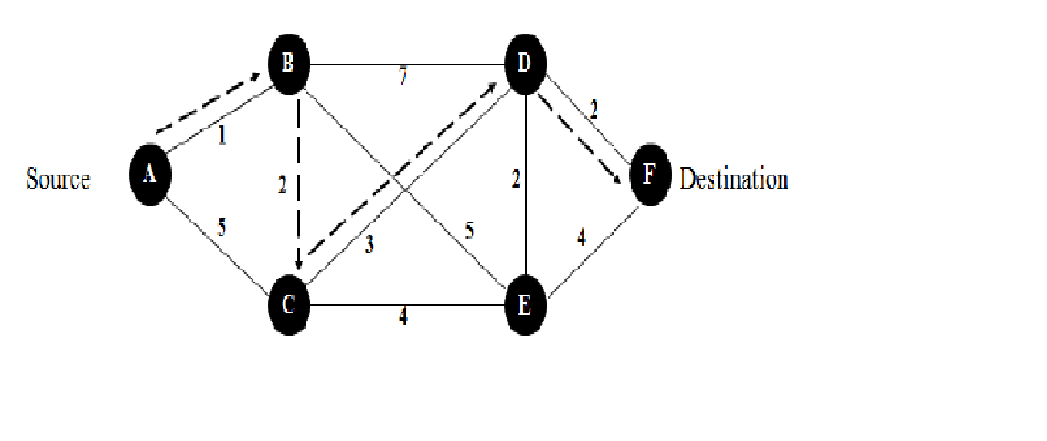
PROCESS OF FINDING SHORTEST PATH
Initially no path is known.
All nodes are labelled infinity.
As packets are sent, the labels change reflecting the distance or better path
Label may be temporary or permanent
When packets are to be routed, label is used to know the distance.
Hourly tests are performed to find to update the label

Slide 11
FLOODING
simple routing technique, source or node sends packets through every outgoing link.
When a packet is received,
the routers send it to all the interfaces except the one on which it was received.
creates too much burden on the network and lots of duplicate packets wandering in the network.

Slide 12
MERITS
all possible routes are active so could be used to send emergency message.
all nodes are visited by the data packets so useful to distribute information.
At least one copy of packet will arrive at the destination

Slide 13
DEMERITS
High traffic load generates at the node
Congestion problem is frequently occur
Changes of duplicate message deliver at the destination.

Slide 14
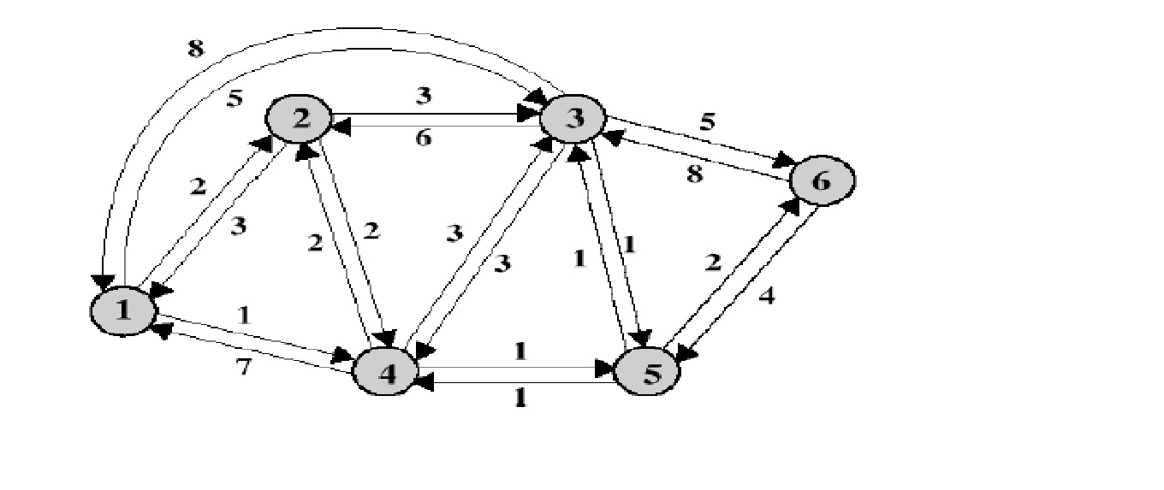
Fig: flooding

Slide 15
DISTANCE VECTOR ROUTING
Distance means routing metric, vector means destination.
RIP is an example of DVR
Completely decentralized
No node has complete information about the costs of all network links
Gradual calculation of path by exchanging information with neighbors

Slide 16
LINK STATE ROUTING
Learning about the neighbors:
It discover its neighbors and learn their network addresses.
It sends Hello packet on each point-to-point line.
Router on other end expected to send back reply.
Measuring line cost:
Measure the delay or cost to each of its neighbors.
Send echo packets
By measuring round trip & dividing it by 2.
Router can get reasonable estimated of delay

Slide 17
Link state packets:
Construct a packet telling all it has just learned.
Packets are made with identity of sender & list of neighbors.
Disturbing the link state packets:
Send the packets to all other routers.
Computing the new Routes:
Compute the shortest path to every other router.
Dijkstra’s algorithm can be run locally to construct the shortest path to destination.

Slide 18
LINK STATE ALGORITHM procedure
Send update only when a network change
Device that detect the change generate LSA.
LSA is transmitted to all neighbours device
Link state routing find the best path by using Dijksta’s algorithm .

Slide 19
Reference
Handouts
Wikipedia
Rasbin
Google
YouTube

Slide 20
Thank you

